Slide 1
Report on Testasp.vulnweb.com
Maseera shaikh

Slide 2
Key introduction
Domain name: Vulnweb.com
Subdomain name: Testasp.vulnweb.com
Vulnerability found: Cross-site Scripting(XSS)
Software Used: Burpsuite
OS used: Kali linux

Slide 3
Steps to reproduce
Step 1: Visit http://testasp.vulnweb.com/
Step 2: On the top menu you will find a search option.
Step 3: Click on it and you will be prompted with the Search box.
Step 4: You can intercept the request in Burp Suite
Step 5: Now you can find different payloads for XSS.
Step 6: Send the request to the intruder and paste all the payloads.
Step 7: Try to find a successful payload for XSS.

Slide 4
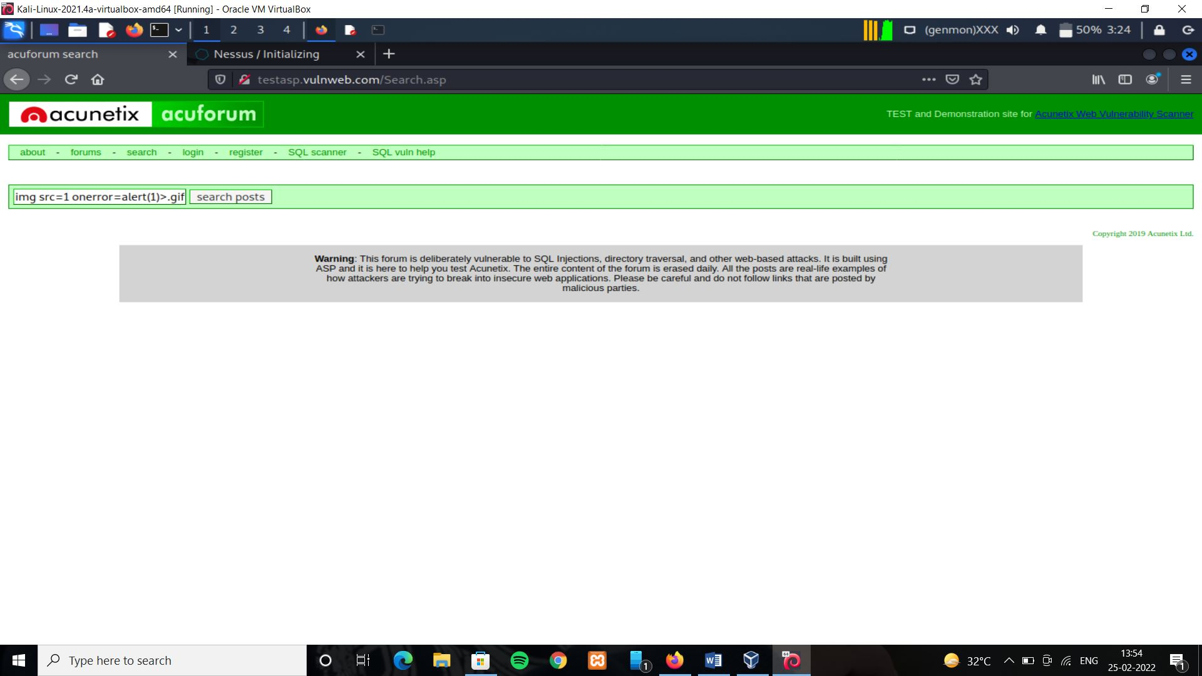
DOM XSS was performed which calls the alert function on loading

Slide 5
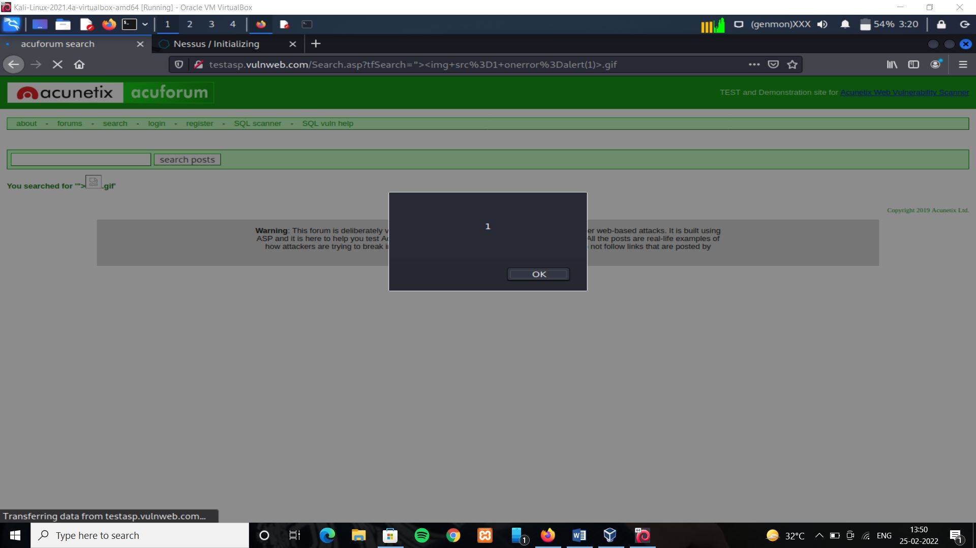

Slide 6
What is XSS? How it works?
Cross-site scripting (also known as XSS) is a web security vulnerability that allows an attacker to compromise the interactions that users have with a vulnerable application. It allows an attacker to circumvent the same origin policy, which is designed to segregate different websites from each other. Cross-site scripting vulnerabilities normally allow an attacker to masquerade as a victim user, to carry out any actions that the user is able to perform, and to access any of the user's data. If the victim user has privileged access within the application, then the attacker might be able to gain full control over all of the application's functionality and data. Cross-site scripting works by manipulating a vulnerable web site so that it returns malicious JavaScript to users. When the malicious code executes inside a victim's browser, the attacker can fully compromise their interaction with the application.

Slide 7
DOM based XSS
DOM-based XSS, where the vulnerability exists in client-side code rather than server-side code.
DOM-based XSS (also known as DOM XSS) arises when an application contains some client-side JavaScript that processes data from an untrusted source in an unsafe way, usually by writing the data back to the DOM.
In the following example, an application uses some JavaScript to read the value from an input field and write that value to an element within the HTML:
var search = document.getElementById('search').value;
var results = document.getElementById('results');
results.innerHTML = 'You searched for: ' + search;
If the attacker can control the value of the input field, they can easily construct a malicious value that causes their own script to execute:
You searched for: <img src=1 onerror='/* Bad stuff here... */'>

Slide 8
Impact of XSS vulnerabilities
The actual impact of an XSS attack generally depends on the nature of the application, its functionality and data, and the status of the compromised user. For example:
In a brochure ware application, where all users are anonymous and all information is public, the impact will often be minimal.
In an application holding sensitive data, such as banking transactions, emails, or healthcare records, the impact will usually be serious.
If the compromised user has elevated privileges within the application, then the impact will generally be critical, allowing the attacker to take full control of the vulnerable application and compromise all users and their data.

Slide 9
How to prevent XSS attacks
Filter input on arrival. At the point where user input is received, filter as strictly as possible based on what is expected or valid input.
Encode data on output. At the point where user-controllable data is output in HTTP responses, encode the output to prevent it from being interpreted as active content. Depending on the output context, this might require applying combinations of HTML, URL, JavaScript, and CSS encoding.
Use appropriate response headers. To prevent XSS in HTTP responses that aren't intended to contain any HTML or JavaScript, you can use the Content-Type and X-Content-Type-Options headers to ensure that browsers interpret the responses in the way you intend.
Content Security Policy. As a last line of defense, you can use Content Security Policy (CSP) to reduce the severity of any XSS vulnerabilities that still occur.

Slide 10
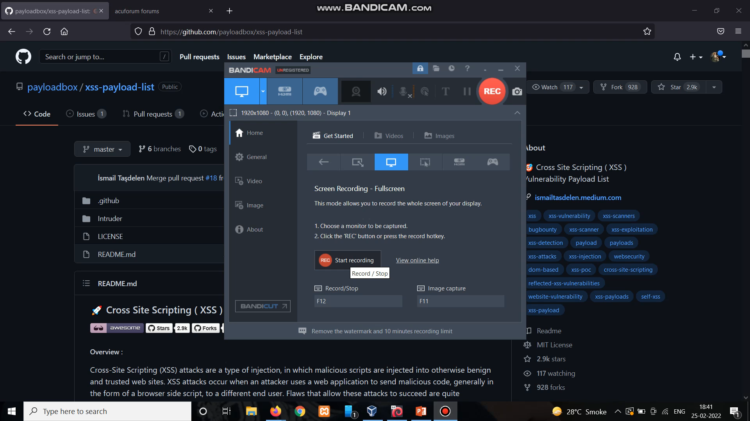
Video demonstration of finding a XSS payload from github and trying on the website
For trying all payloads use burpsuite and get its status

